Slide 1
Solar tracking system
By
Abdelkareem soubar
Taha khateb

Slide 2
Overview
solar tracker, a system that positions an object at an angle relative to the Sun. The most-common applications for solar trackers are positioning photovoltaic (PV) panels (solar panels) so that they remain perpendicular to the Sun's rays and positioning space telescopes so that they can determine the Sun's direction.
We have implemented the idea through using an nodemcu esp8266 along side having an LDR sensor plus 2 servo motors

Slide 3
problem
Some of the things that we faced
We only have one analog pin
Blynk connection is stable
On nodemcu we can't read the current voltage
Power supply is not stable
Some ofPreparation
Planned the design out for the hardware implementation
Had all of the software required installed
Gathered all of the componentes

Slide 4
Solution

Slide 5
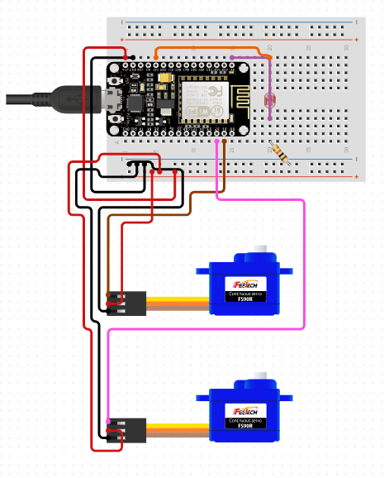

Slide 6
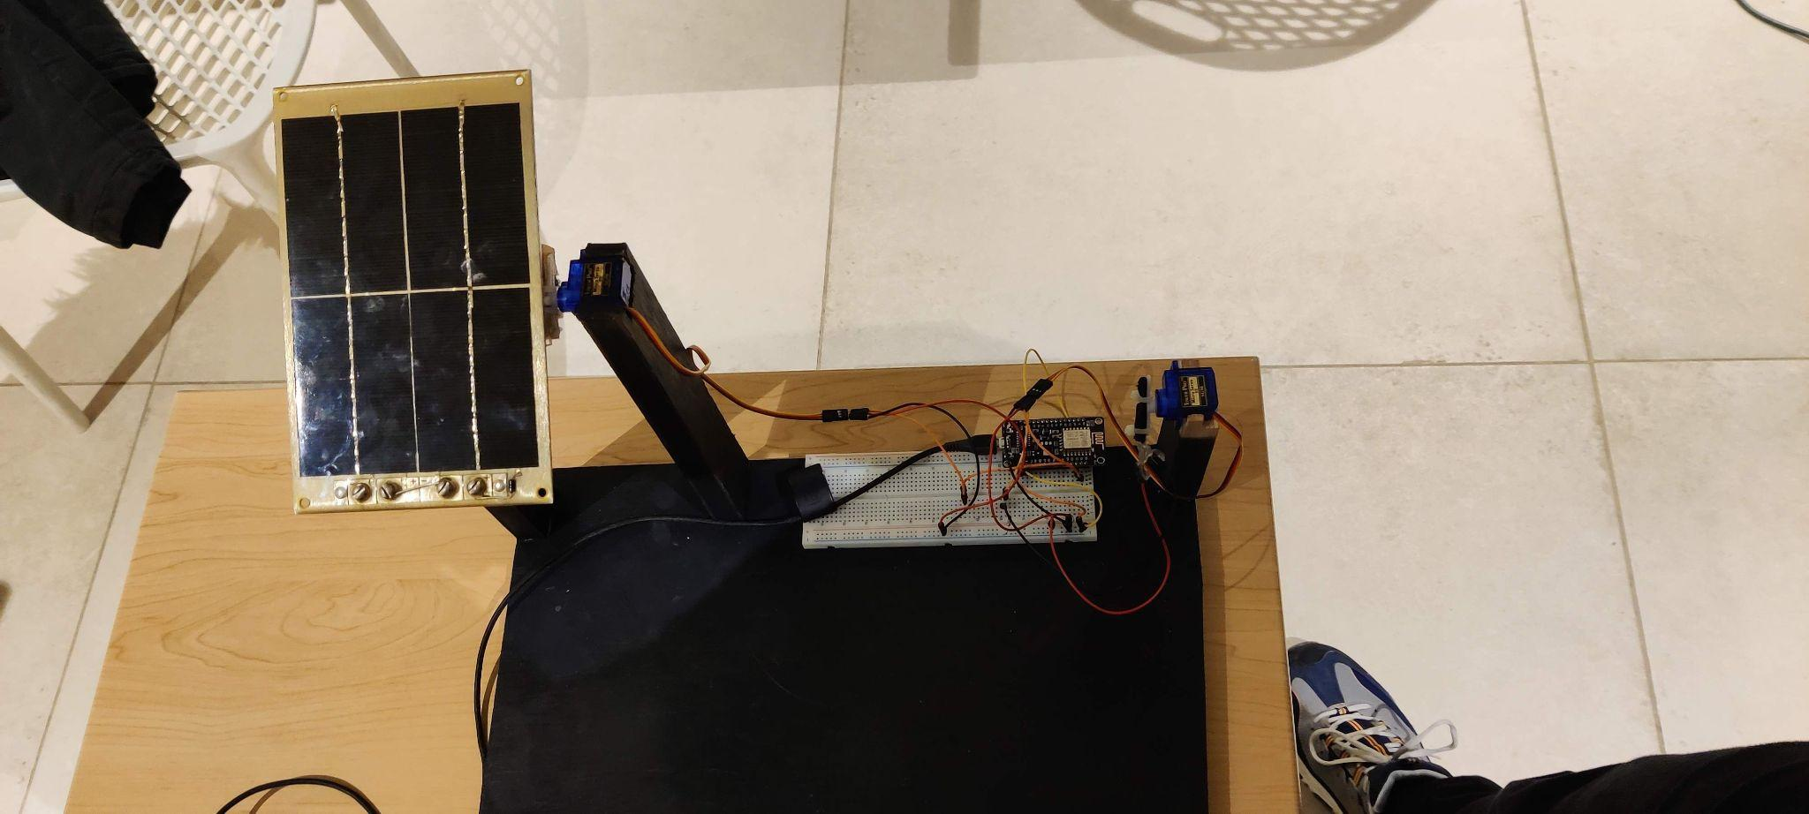
Tracker solution
It tracks the position of the highest amount of light available and it re positions the pv cell to the new location

Slide 7
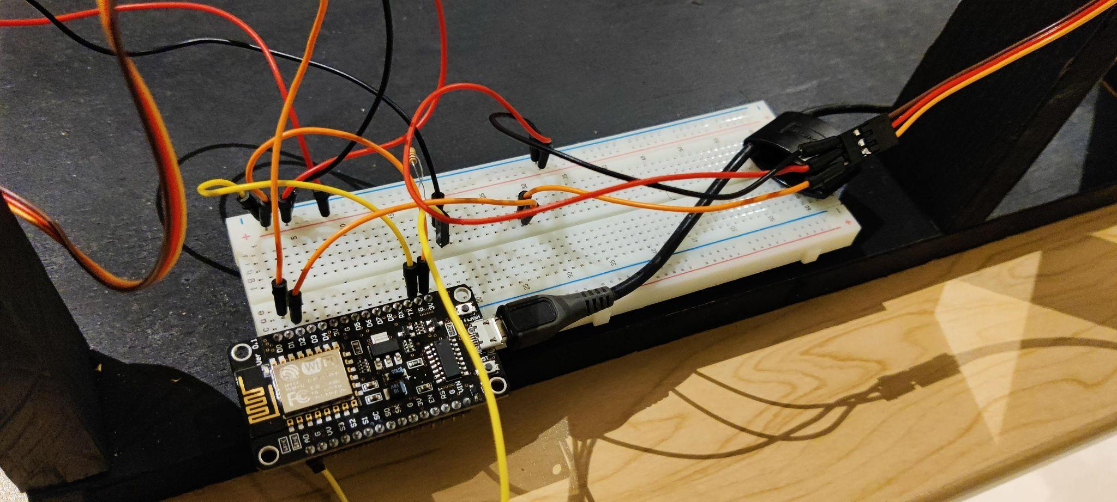
Thank you
Q/A

